Slide 1
ELECTROCHEMISTRY 4
Free energy and EMF
Nernst Equation
Problems
Applications
Dr.Rani Pavithran
Assistant Professor
Department of Chemistry
College of Engineering Trivandrum

Slide 2
Relation between free energy and EMF of the cell
Free Energy (G) is defined as energy available(per mole) that can be completely converted into mechanical work. Since electrical energy is a form of energy that can be completely converted into mechanical work, decrease of free energy is equal to electric energy produced in a reversible cell.
Electric energy produced per mole = quantity of charge in one mole x EMF
For the reaction, M^{n+}(aq) + ne M(s)
Quantity of charge in one mole = nF
Therefore electric energy per mole = nFE
Since decrease of free energy is converted to electrical energy
G = -nFE, where F is called Faraday which is the charge of one mole of electrons i.e., F = 6.023x 10²³ x 1.6 x 10⁻¹⁹ = 96500C

Slide 3

Nernst Equation
Nernst equation gives us the effect of electrolyte concentration on electrode potential.
Consider a general reduction reaction, taking place at the electrode,
M^{n+} _{aq} + ne M(s),
The decrease in free energy, G accompanying this process is given by the well known thermodynamic equation. (van’t Hoff's equation)
where Q is called reaction quotient, which is the ratio of activities of products to the reactants in a non equilibrium situation. (At Equilibrium G = 0 and Q = K)
In a reversible cell, electrical energy is produced at the expense of decrease in free energy, and free energy is related with EMF of the cell as :

Slide 4
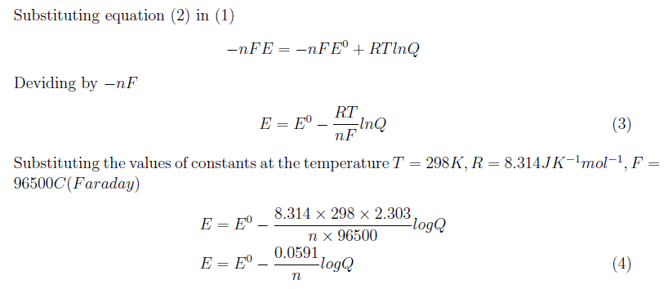
Nernst Equation
Equations (3) and (4) are different forms of Nernst equations

Slide 5
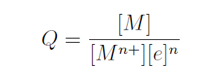
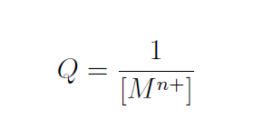
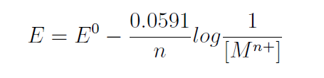
Nernst Equation for single Electrode
For a single electrode reaction M^{n+}_{(aq)}+ne M(s)
reaction quotient Q can be written as
In dilute solution, activities are replaced by molar concentration, also the concentration terms [e] is taken as one and for pure solid [M] is also taken as one, therefore the reaction quotient Q becomes
Substituting in Nernst equation,

Slide 6

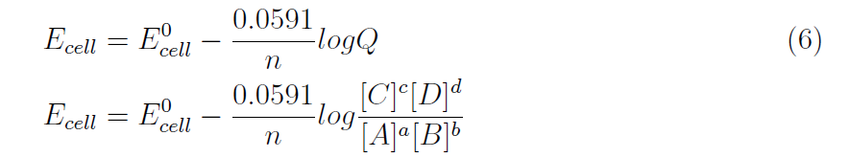

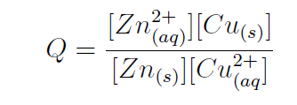
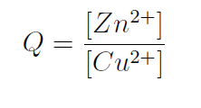
Nernst Equation for a complete cell
For a cell reaction aA + bB cC + dD
reaction quotient Q can be written as
Modified form of equation (4) for complete cell is given by
For example the Daniel cell reaction

Slide 7
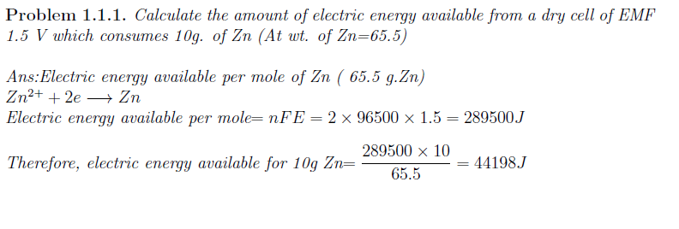
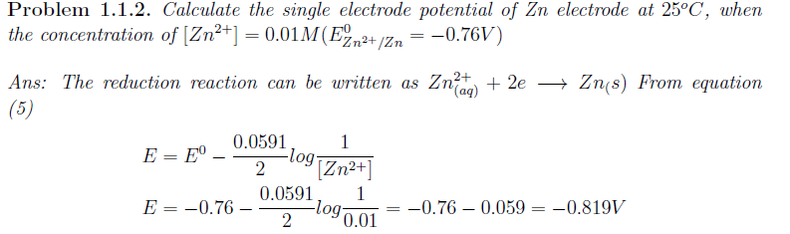
Problems

Slide 8
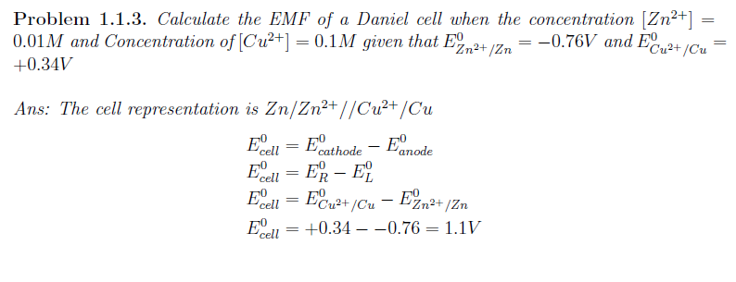
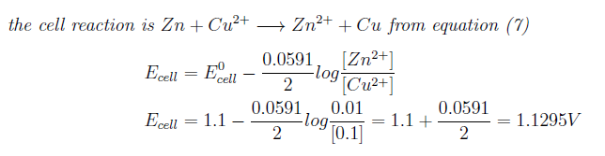

Slide 9
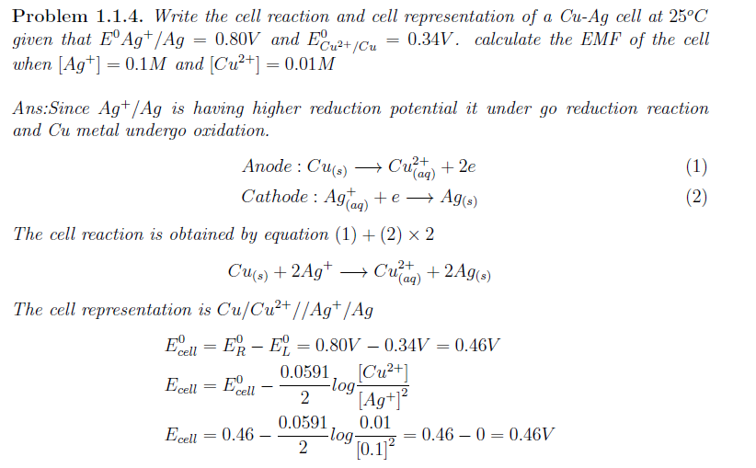

Slide 10
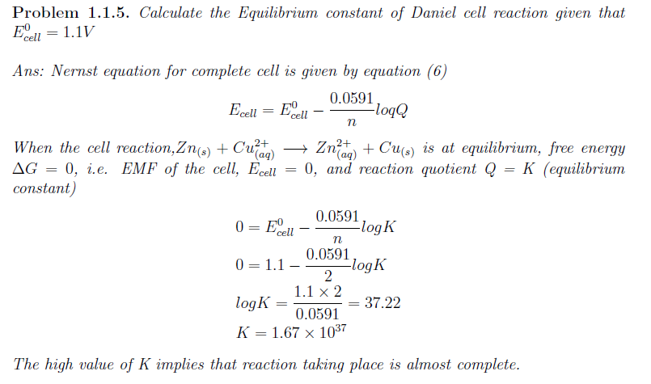

Slide 11
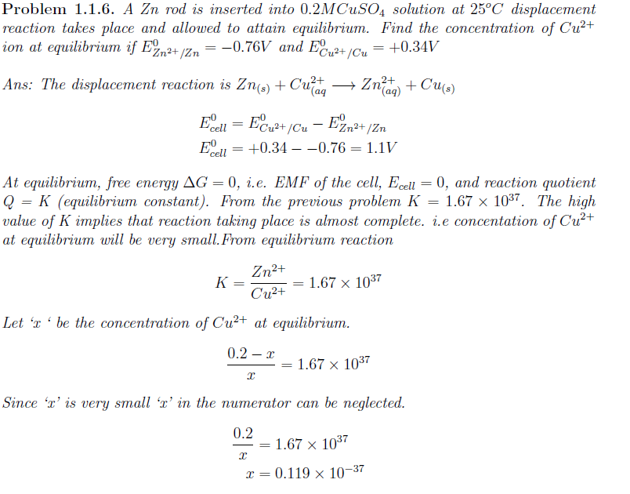

Slide 12
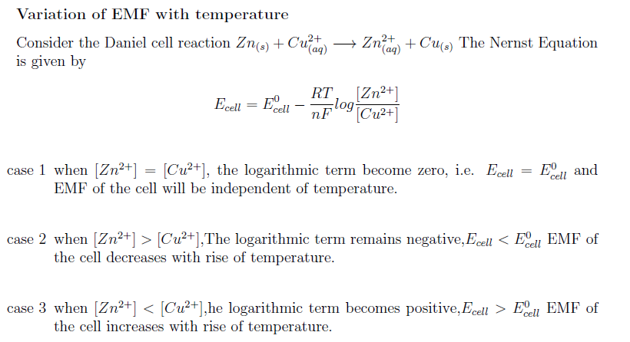
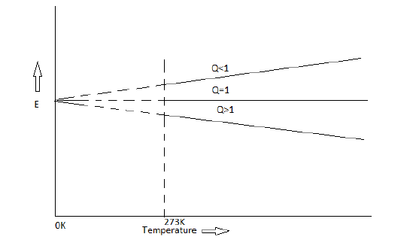

Variation of EMF with temperature
In Daniel cell reaction, Nernst equation is
E_{cell} = E⁰_{cell} – (2.303 RT/nF )log[Zn²⁺]/[Cu²⁺]

Slide 13
Variation of EMF with temperature

Slide 14
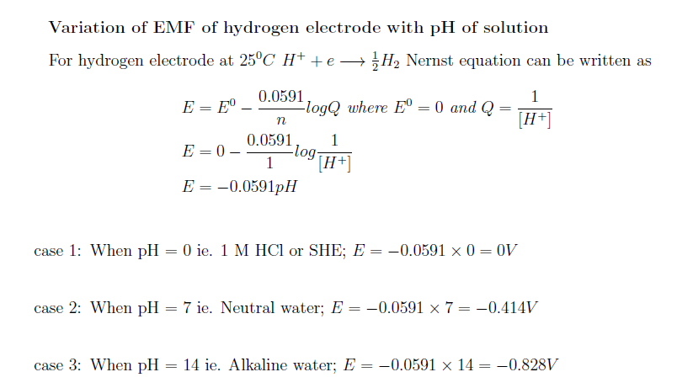

Slide 15
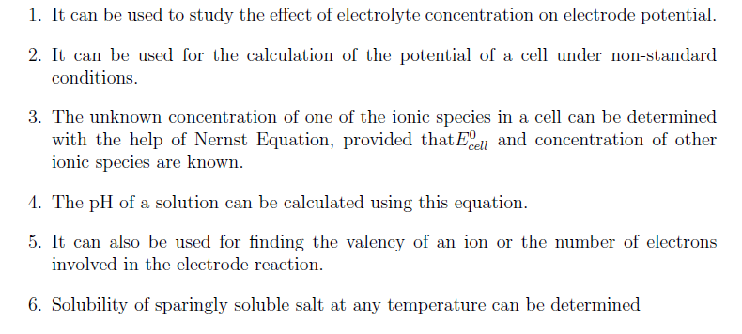
Applications of Nernst Equation

